Slide 1
Introduction to Computer Programing and Java
Textbook: Java How to Program, 10/e
Late Objects Version

Slide 2
References & Reading
The content is mainly selected (sometimes modified) from the original slides provided by the authors of the textbook
Readings
Chapter 1- Introduction to Computers, Internet, and Java
A short history about programming Languages (https://en.wikipedia.org/wiki/History_of_programming_languages)

Slide 3
Outline
1.1 Introduction
1.2 Hardware and Software
1.4 Machine Languages, Assembly Languages and High-Level Languages
-.- Programming Paradigms
1.6 Operating Systems
1.7 Programming Languages
1.8 Java
1.9 Typical C++ Development Environment

Slide 4
1.1 Introduction
Computers (often referred to as hardware) are controlled by software (i.e., the instructions you write to command the computer to perform actions and make decisions).
You’ll learn to write instructions commanding computers to perform tasks.
Java is one of the world’s most widely used computer programming languages.

Slide 5
1.1 Introduction (Cont.)
For many organizations, the preferred language for meeting their enterprise programming needs is Java.
Java is also widely used for implementing Internet-based applications and software for devices that communicate over a network.
According to Oracle, 97% of enterprise desktops, 89% of PC desktops, three billion devices (Fig. 1.1) and 100% of all Blu-ray Disc™ players run Java, and there are over 9 million Java developers. (http://www.oracle.com/technetwork/articles/java/javaone12review-1863742.html.)

Slide 6
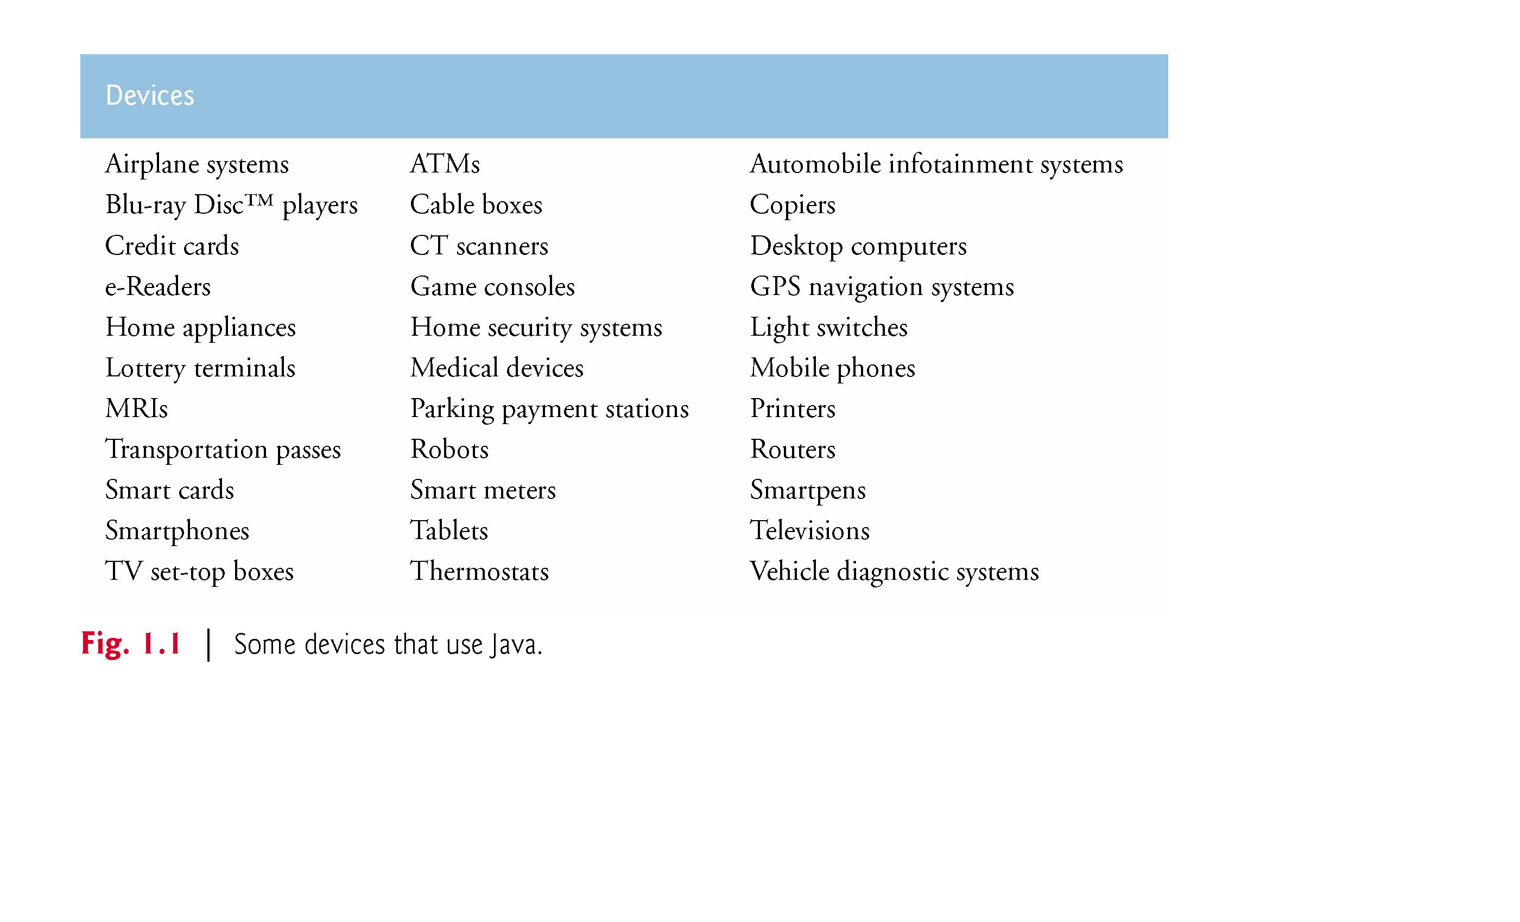

Slide 7
1.1 Introduction (Cont.)
Java Standard Edition (Java SE) contains the capabilities needed to develop desktop and server applications.
Java How to Program, 10/e is based on Java Standard Edition 7 (Java SE 7) and Java Standard Edition 8 (Java SE 8)
Java Enterprise Edition (Java EE) is geared toward developing large-scale, distributed networking applications and web-based applications.
Java Micro Edition (Java ME) a subset of Java SE, geared toward developing applications for resource-constrained embedded devices, such as: Smartwatches, MP3 players, and more.

Slide 8
1.2 Hardware and Software
Computers can perform calculations and make logical decisions phenomenally faster than human beings can.
Today’s personal computers can perform billions of calculations in one second—more than a human can perform in a lifetime.
Supercomputers are already performing thousands of trillions (quadrillions) of instructions per second!
Computers process data under the control of sequences of instructions called computer programs.
A computer consists of various devices referred to as hardware.
The programs that run on a computer are referred to as software.

Slide 9
1.2.2 Computer Organization
Computers can be envisioned as divided into six logical units or sections:
Input unit. This “receiving” section obtains from input devices and places it at the disposal of the other units so that it can be processed.
Output unit. This “shipping” section takes information that the computer has processed and places it on various output devices to make it available for use outside the computer.
Memory unit. This rapid-access, relatively low-capacity “warehouse” section retains information that has been entered through the input unit, making it immediately available for processing when needed. It also retains processed information until it can be placed on output devices by the output unit. Information in the memory unit is volatile. The memory unit is often called either memory or primary memory.

Slide 10
1.2.2 Computer Organization (cont.)
Arithmetic and logic unit (ALU). This “ manufacturing” section performs calculations. It also contains the computer’s decision mechanisms. In today’s systems, the ALU is usually implemented as part of the next logical unit, the CPU.
Central processing unit (CPU). This “ administrative” section coordinates and supervises the operation of the other sections.
Tells the input unit when information should be read into the memory unit
Tells the ALU when information from the memory unit should be used in calculations
Tells the output unit when to send information from the memory unit to certain output devices.
Many of today’s computers have multiple CPUs and, hence, can perform many operations simultaneously—such computers are called multiprocessors. A multi-core processor implements multiprocessing on a single integrated circuit chip.

Slide 11
1.2.2 Computer Organization (cont.)
Secondary storage unit. This is the long-term, high-capacity “warehousing” section. Programs or data not actively being used by the other units normally are placed on secondary storage devices (e.g., your hard drive) until they’re again needed, possibly hours, days, months or even years later. Therefore, information on secondary storage devices is said to be persistent.

Slide 12
1.4 Machine Languages, Assembly Languages and High-Level Languages
Programmers write instructions in various programming languages, some directly understandable by computers and others requiring intermediate translation steps.
Programming languages may be divided into three general types:
Machine languages
Assembly languages
High-level languages

Slide 13
1.4 Machine Languages, Assembly Languages and High-Level Languages (Cont.)
Machine Languages
Any computer can directly understand only its own machine language (machine-dependent).
Consist of strings of numbers (ultimately reduced to 1s and 0s) that instruct computers to perform their most elementary operations one at a time.
Writing programs in machine language is very hard and error prone
Assembly Languages and Assemblers
Low level languages where strings of 1s and 0s are replaced by mnemonics: ADD, SUB, etc.
Translator programs called Assemblers convert early assembly-language programs to machine language.

Slide 14
1.4 Machine Languages, Assembly Languages and High-Level Languages (Cont.)
High-Level Languages and Compilers
High-level languages allow to write instructions that look almost like everyday English and contain commonly used mathematical notations: Single statements accomplish substantial tasks.
Translator programs called Compilers convert high-level language programs into machine language.
Writing programs in high-level language is faster and easier to maintain than in assembly language

Slide 15
Programming Paradigms
Programming paradigm is a way of programming
Approaches to problem-solving
Java supports Procedural programming, Object-Oriented Programming (OOP), and other programming paradigms
Procedural (Structured or Imperative) programming:
Use of high-level control structures: decisions, sequences, and loops
Rely on procedures: a procedure is a set of ordered actions
Divide the problem into small procedures
A single procedure provide a solution for a single problem
Ignore data design and not easy to be reused
Object-Oriented Programming:
Rely on objects: contains data and subroutines
Reusable software components
Easier to understand, correct and modify.

Slide 16
1.6 Operating Systems
Software systems that make using computers more convenient.
Provide services that allow each application to execute safely, efficiently and concurrently (i.e., in parallel) with other applications.
The software that contains the core components of the operating system is called the kernel.
Popular desktop operating systems include Linux, Windows 7 and Mac OS X.
Popular mobile operating systems used in smartphones and tablets include Google’s Android, Apple’s iOS (for its iPhone, iPad and iPod Touch devices), Windows Phone and Blackberry OS.

Slide 17
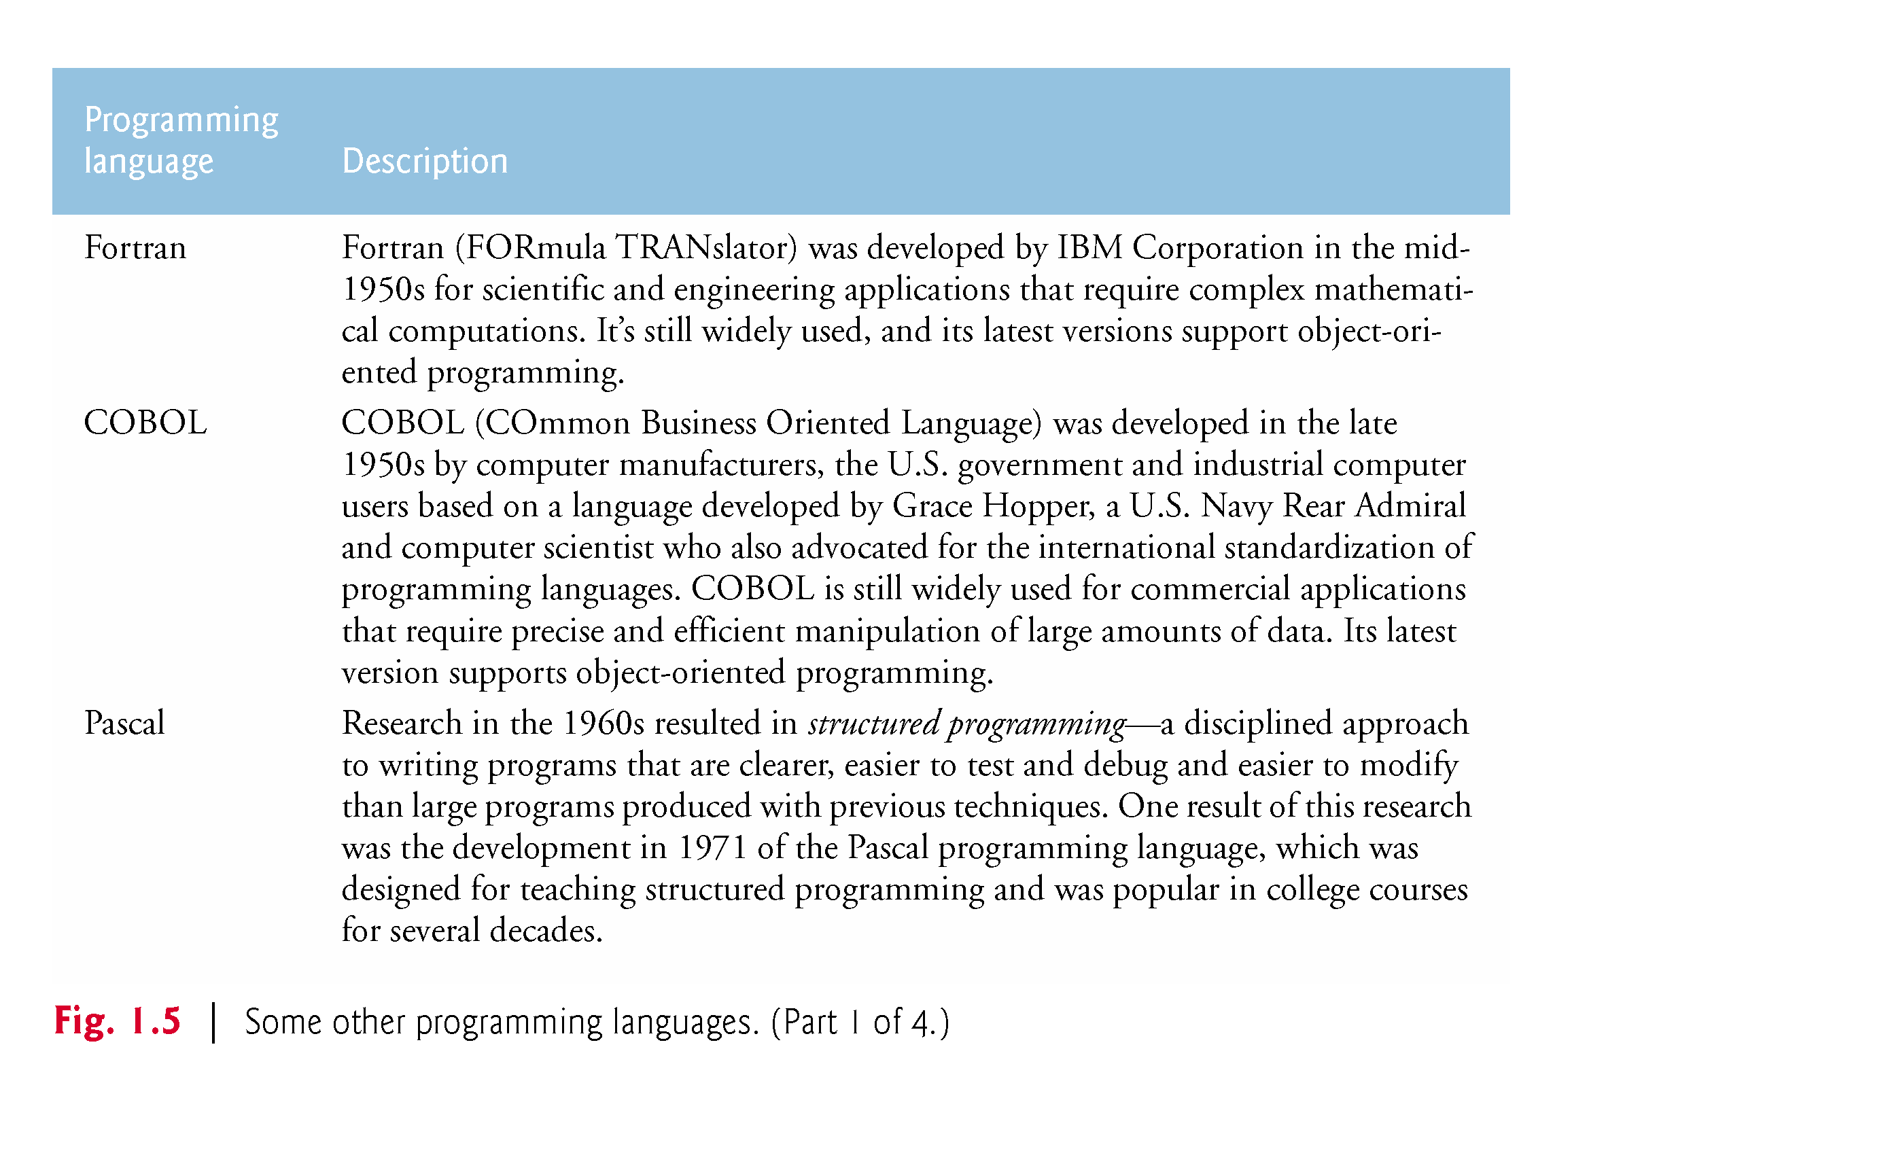
1.7 Programming Languages

Slide 18
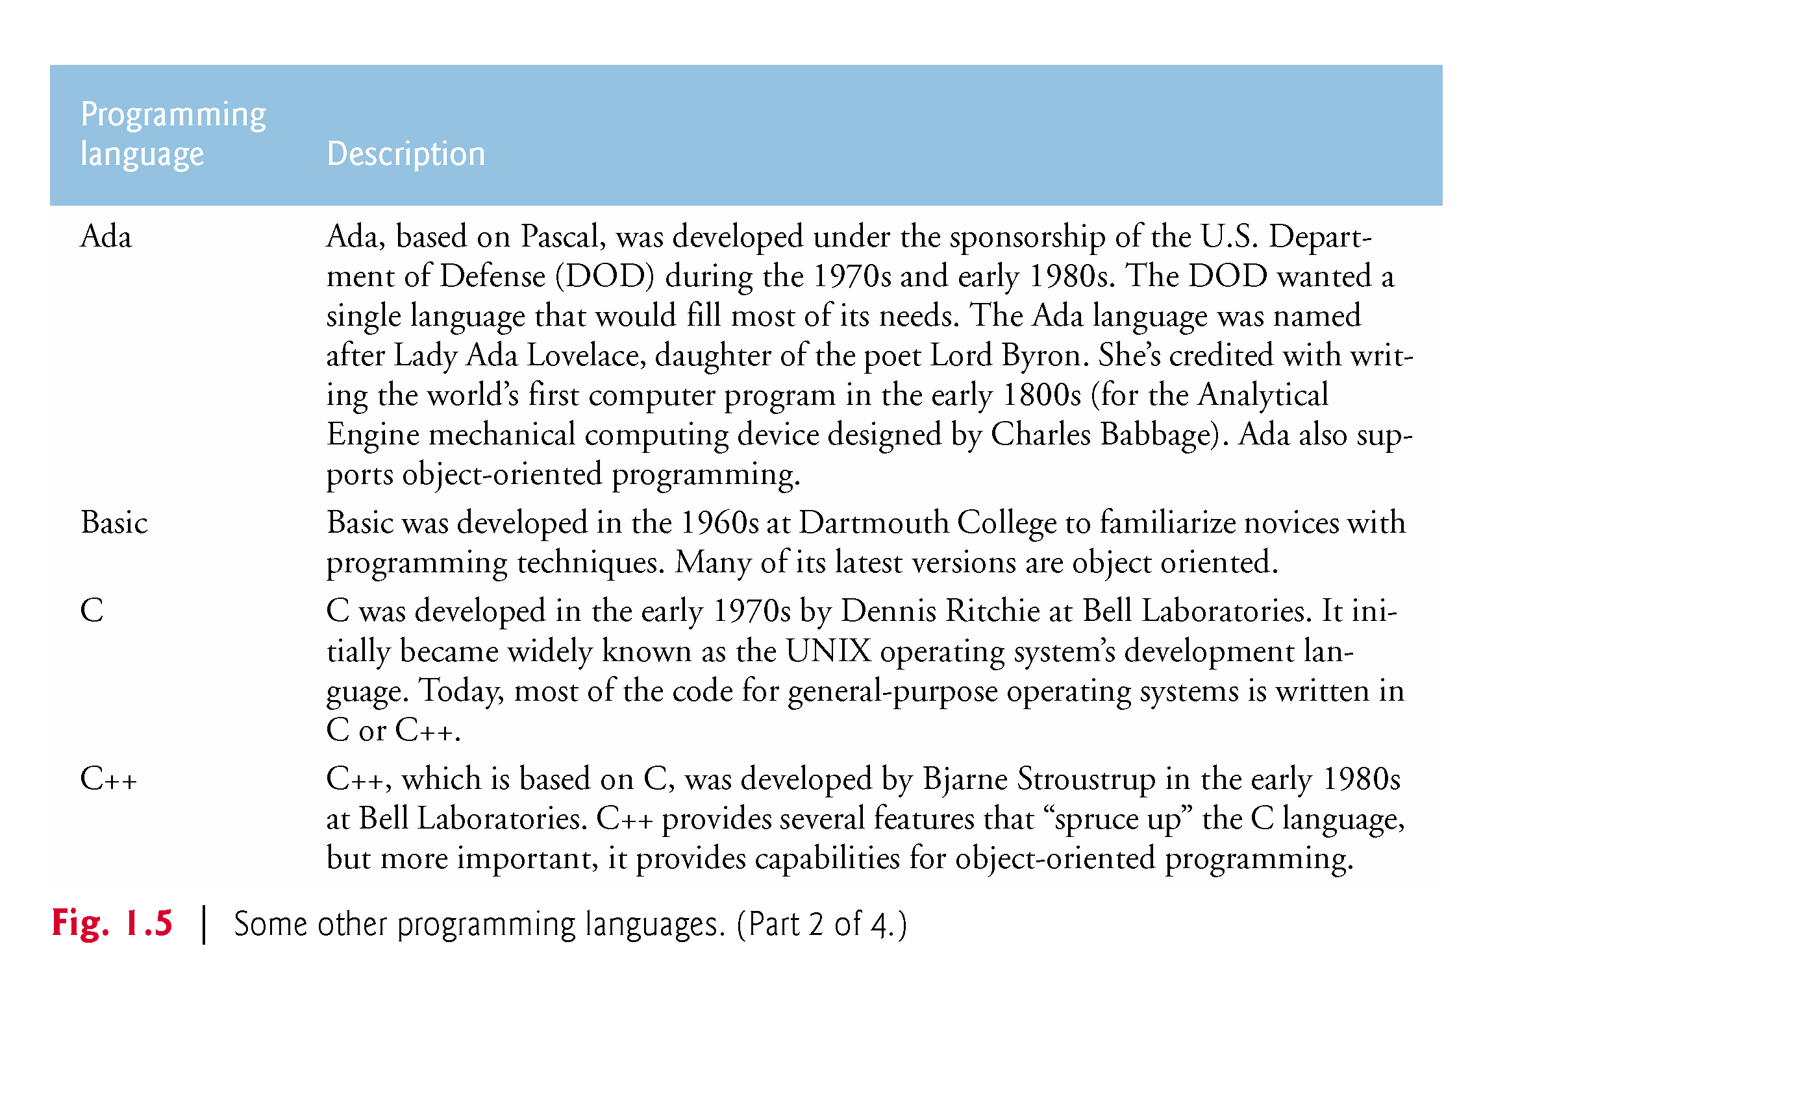

Slide 19
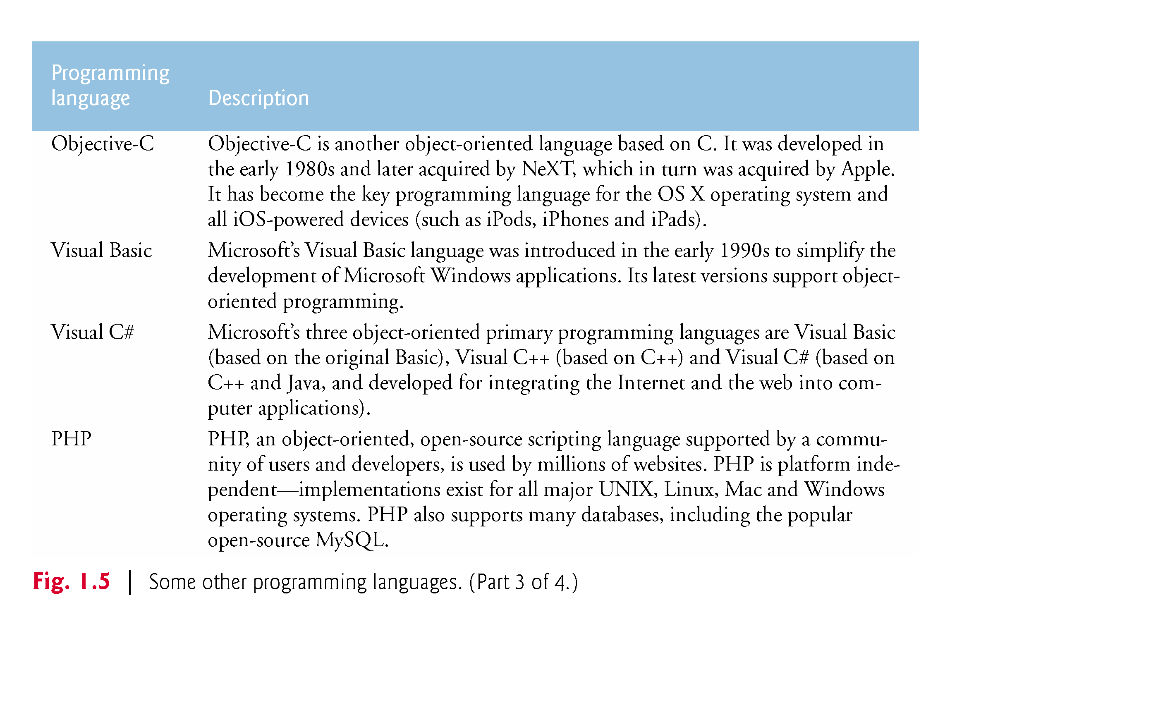

Slide 20
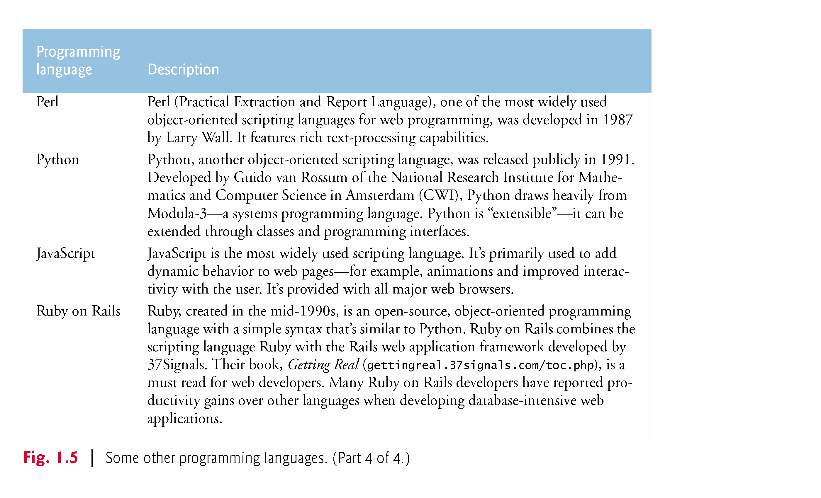

Slide 21
1.8 Java
Microprocessors have had a profound impact in intelligent consumer-electronic devices.
1991
Recognizing this, Sun Microsystems funded an internal corporate research project led by James Gosling, which resulted in a C++-based object-oriented programming language that Sun called Java.
Key goal of Java is to be able to write programs that will run on a great variety of computer systems and computer-controlled devices.
This is sometimes called “write once, run anywhere.”

Slide 22
1.8 Java (Cont.)
1993
The web exploded in popularity
Sun saw the potential of using Java to add dynamic content to web pages.
Java drew the attention of the business community because of the phenomenal interest in the web.
Java is used to develop large-scale enterprise applications, to enhance the functionality of web servers, to provide applications for consumer devices and for many other purposes.

Slide 23
1.8 Java (Cont.)
Java Class Libraries
Rich collections of existing classes and methods
Also known as the Java APIs (Application Programming Interfaces).

Slide 24
1.9 A Typical Java Development Environment
Normally there are five phases
edit
compile
load
verify
execute.

Slide 25
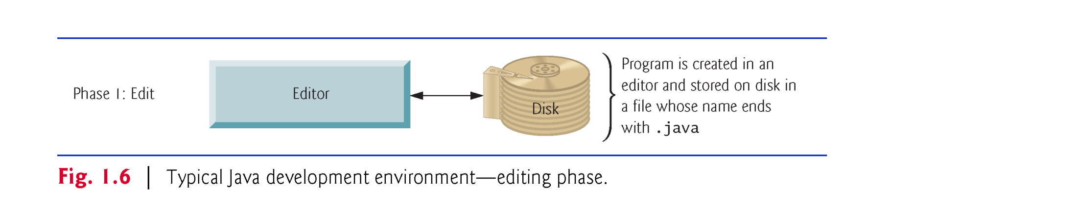
1.9 A Typical Java Development Environment (Cont.)
Phase 1 consists of editing a file with an editor program
Using the editor, you type a Java program (source code).
Make any necessary corrections.
Save the program.
Java source code files are given a name ending with the .java extension indicating that the file contains Java source code.

Slide 26
1.9 A Typical Java Development Environment (Cont.)
Linux editors: vi and emacs.
Windows provides Notepad.
OSX provides TextEdit.
Many freeware and shareware editors available online:
Notepad++ (notepad-plus-plus.org)
EditPlus (www.editplus.com)
TextPad (www.textpad.com)
jEdit (www.jedit.org).
Integrated development environments (IDEs)
Provide tools that support the software development process, such as editors, debuggers for locating logic errors (errors that cause programs to execute incorrectly) and more.

Slide 27
1.9 Java and a Typical Java Development Environment (Cont.)
Popular Java IDEs
Eclipse (www.eclipse.org)
NetBeans (www.netbeans.org)
IntelliJ IDEA (www.jetbrains.com)
On the book’s website at www.deitel.com/books/jhtp10
Dive-Into® videos that show you how to execute this book’s Java applications and how to develop new Java applications with Eclipse, NetBeans and IntelliJ IDEA.

Slide 28

1.9 A Typical Java Development Environment (Cont.)
Phase 2: Compiling a Java Program into Bytecodes
Use the command javac (the Java compiler) to compile a program. For example, to compile a program called Welcome.java, you’d type
javac Welcome.java
If the program compiles, the compiler produces a .class file called Welcome.class that contains the compiled version.

Slide 29
1.9 A Typical Java Development Environment (Cont.)
Java compiler translates Java source code into bytecodes that represent the tasks to execute.
Bytecode instructions are platform independent
The Java Virtual Machine (JVM)—a part of the JDK and the foundation of the Java platform—executes bytecodes.
Virtual machine (VM)—a software application that simulates a computer
Hides the underlying operating system and hardware from the programs that interact with it.
Bytecodes are portable – If the same VM is implemented on many computer platforms, applications written for that type of VM can be used on all those platforms.
The JVM is invoked by the java command: java Welcome

Slide 30
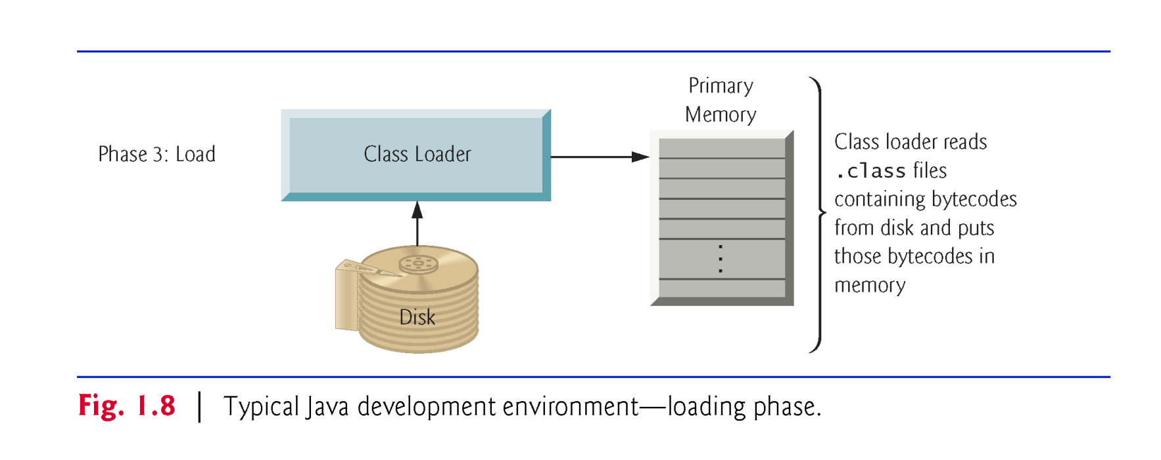
1.9 A Typical Java Development Environment (Cont.)
Phase 3: Loading a Program into Memory
The JVM places the program in memory to execute it—this is known as loading.
Class loader takes the .class files containing the program’s bytecodes and transfers them to primary memory.
Also loads any of the .class files provided by Java that your program uses.

Slide 31
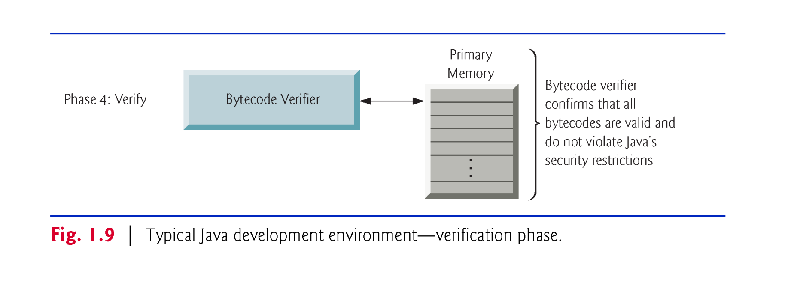
1.9 A Typical Java Development Environment (Cont.)
Phase 4: Bytecode Verification
As the classes are loaded, the bytecode verifier examines their bytecodes
Ensures that they’re valid and do not violate Java’s security restrictions.

Slide 32
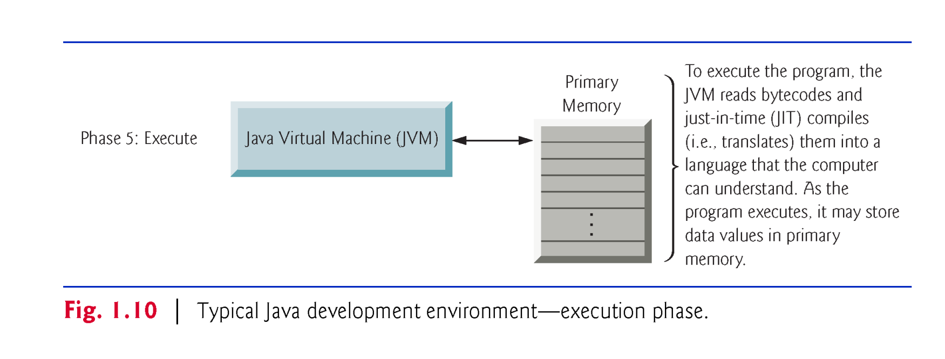
1.9 A Typical Java Development Environment (Cont.)
Phase 5: Execution
The JVM executes the program’s bytecodes.
JVMs typically execute bytecodes using a combination of interpretation and so-called just-in-time (JIT) compilation.
Analyzes the bytecodes as they’re interpreted
A just-in-time (JIT) compiler—such as Oracle’s Java HotSpot™ compiler—translates the bytecodes into the underlying computer’s machine language.

Slide 33
1.9 A Typical Java Development Environment (Cont.)
When the JVM encounters these compiled parts again, the faster machine-language code executes.
Java programs go through two compilation phases
One in which source code is translated into bytecodes (for portability across JVMs on different computer platforms) and
A second in which, during execution, the bytecodes are translated into machine language for the actual computer on which the program executes.

